Slide 1
House Price Prediction Project
By: Tomas H, Rita E, Sandra N, Ihechi D

Slide 2
Why did we choose this topic?
Hot topic!🔥
The housing market is widely talked about, especially since the start of the COVID-19 pandemic.
Impact
We are all impacted by the housing market in one way or another so this is an important topic for us.

Slide 3

Questions we plan to answer
How accurately can a model predict the sale price of a house?
What are the most important features that can impact the price of a house?

Slide 4
Dataset Used: Real dataset of house prices sold in Seattle, Washington, USA between August and December 2022
Seattle, Washington

Slide 5
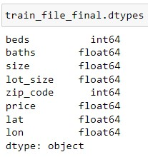
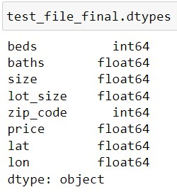
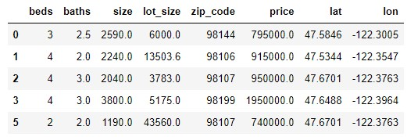
Dataset Description
First dataset: Well-structured testing and training CSV files from Kaggle (dataset link)
8 columns: ‘beds’, ‘baths’, ‘size’, ‘size_units’, ‘lot_size’, ‘lot_size_units’, ‘zip_code’, and ‘price’
Target column is ‘price’, and all other columns are the features
Second dataset: All Zip Codes in the United States with their coordinates (dataset link)
Used VLOOKUP in Excel to find the corresponding coordinates (‘lat’, ‘lon’) from the second dataset to the Zip Code in the first dataset (testing and training files)
File was then merged with the testing and training files using Pandas to create the final Data Frame

Slide 6


Tools & Technologies
Visualization: Tableau, Seaborn, Matplotlib
Data Analysis: Jupyter Notebook, Excel
Algorithms: Linear Regression, Random Forest Regression, k-Nearest Neighbours (k-NN)

Slide 7
THANKS!
Any questions?
Please email or message us on Slack.

